Slide 1


BANK CRM ANALYSIS
A N K I T A R O Y
1 0 - 1 1 - 2 0 2 4

Slide 2

Agenda
Problem Statement
Data Description Insights Recommendation Conclusion

Slide 3

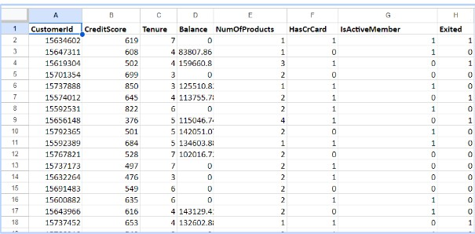
Problem Statement
You are an analytical CRM (Customer Relationship Management) specialist hired by a bank to extract meaningful insights from various customer-related datasets. The bank aims to reduce customer churn, improve service delivery, and enhance customer satisfaction. They have provided you with datasets including customer demographics, transaction details, customer exit information, and active customer profiles.

Slide 4
Data Description:
RowNumber: The row number in the dataset, likely used for reference or indexing. CustomerId: A unique identifier for each customer.
CreditScore: A numerical representation of the customer's creditworthiness. Credit score:
Excellent: 800–850
Very Good: 740–799
Good: 670–739
Fair: 580–669
Poor: 300–579
GeographyID: A numerical identifier that likely corresponds to a geographical location, such as a country or region.
GenderID: A numerical identifier for the customer's gender, where for example, '1' could represent male and '2' could represent female.

Slide 5

Age: The age of the customer.
Tenure: The number of years the customer has been with the bank. Balance: Current balance in the customer's account.
NumOfProducts: refers to the number of products that a customer has purchased through the bank.
HasCrCard: denotes whether or not a customer has a credit card. This column is also relevant, since people with a credit card are less likely to leave the bank.
1 represents credit card holder
0 represents non credit card holder
IsActiveMember: active customers are less likely to leave the bank (as per the criteria defined by the bank for identifying the activeness).
1 represents Active Member
0 represents Inactive Member
Estimated Salary: as with balance, people with lower salaries are more likely to eave the bank compared to those with higher salaries.
Exited: whether or not the customer left the bank.
0 represents Retain
1 represents Exit
Bank DOJ: date when the Customer associated/joined with the bank.

Slide 6

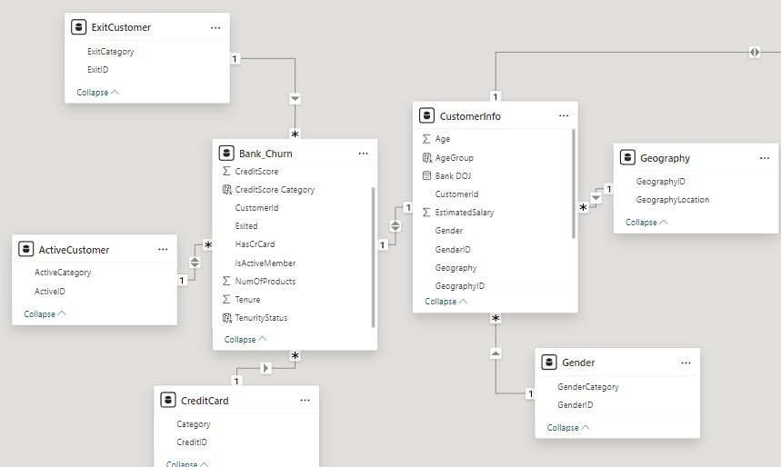
Database Schema

Slide 7
Data Overview
Total Balance: 765M
Active customers: 5151
Exited Customers: 2037 Total customers: 10k
Credit Card customers: 7055 Avg Credit Score: 650.53 Churn Rate: 20.37

Slide 8
Key Metrics and Visualizations
Customer distribution by age group, credit score, geography and tenure.
Breakdown of credit card holders and number of bank products used per customer. Churn rates by age, geography, credit score, and tenure status.
Average balance and salary comparisons between retained and exited customers. Customer growth trend by year, showing acquisition over time.
Comparative metrics on total balance, average age, average balance, and total customers across gender and geographic locations.

Slide 9
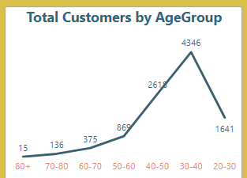
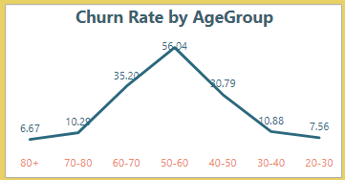
Insights and Recommendations
Customer distribution and Churn rate by age group, credit score, geography and tenure
Younger customers (20-40) have low churn, indicating a good product fit and high satisfaction. We should focus on expanding youth-focused products and replicating successful strategies from this segment.
Older groups (50-70) with high churn need more attention and require retention strategies to improve loyalty. For the 80+ age group, being a smaller segment, the priority should be to engage them through tailored offerings and marketing efforts.

Slide 10
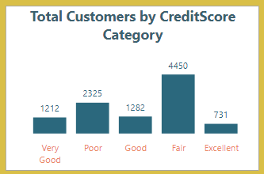
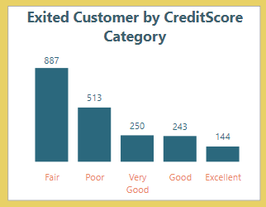
The Fair and Poor credit score groups have the largest customer base (4,450) but also the highest number of exits (687) which shows retention issues. To retain them, we should provide credit improvement programs and financial education. For customers in the Good, Very Good, and Excellent categories, we can offer premium products to reward and retain their creditworthiness.

Slide 11
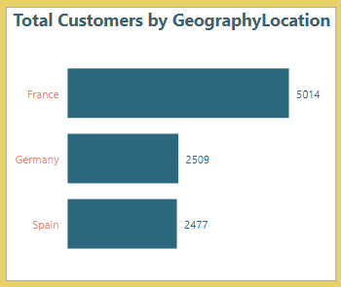
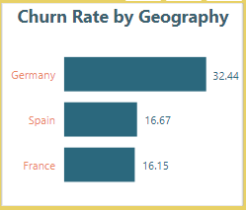
France has the most stable market, with the largest customer base and lowest churn. Germany has high churn despite fewer customers, while Spain has a balanced market.
Focus on reducing Germany’s churn with market research and retention programs. Additionally by using successful strategies from France and Spain and create localized plans for all regions to prevent churn.

Slide 12
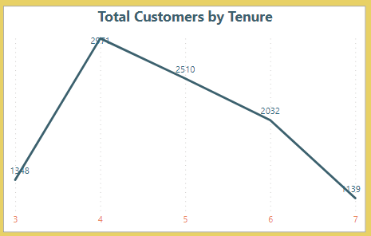
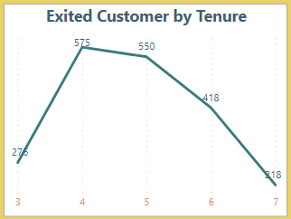
Customer numbers peak at 4 years (2,210) but decline after, with exits also highest at 4-5 years (575 and 550, respectively). This 4-5 year period is critical, marking a turning point in the customer lifecycle.
Engage customers before 4 years with proactive support. Enhance loyalty programs with special benefits at 4 years, incentives beyond 5 years, and personalized strategies to retain long-term customers.

Slide 13

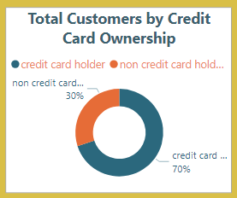
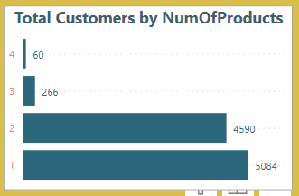
Breakdown of credit card holders and number of bank products used per customer
Most customers have credit cards (70%) and own 1 or 2 products, but very few (326) have 3 or more, showing potential for cross-selling.
Offer tailored credit card deals for non-holders and encourage more product adoption with bundles, rewards, and personalized recommendations.

Slide 14
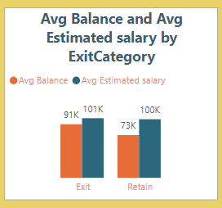
Average balance and salary comparisons between retained and exited customers
The salary difference between exiting (101K) and retained customers (100K) is small, suggesting salary likely isn’t a major factor in churn. However, exiting customers had higher balances (91K) compared to those retained (73K), indicating high-balance customers might be leaving for better rates.
Focus on retaining customers with balances above 75K by offering better interest rates and loyalty rewards. Monitor balance and salary ratios to identify at-risk customers and apply retention strategies early.

Slide 15
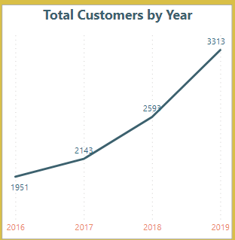
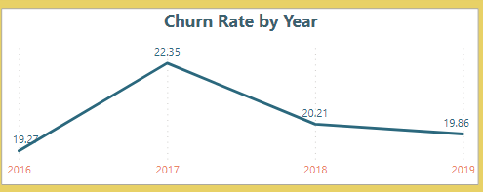
Customer growth trend by year, showing acquisition over time
Customer numbers grew from 1,951 in 2016 to 3,333 in 2019, with the highest growth between 2018-2019. Churn peaked at 22.35% in 2017 but improved to 19.86% by 2019, showing better retention. To maintain this progress, focus should be on repeating successful strategies, addressing 2017 churn causes, using early warning systems, scaling customer support, tracking churn patterns, and balancing growth with retention efforts.

Slide 16
Conclusion
Focus on youth-friendly products and loyalty programs for older customers to address high churn.
Offer credit improvement programs to help poor credit scores customers to manage finances better and reward high scorers with premium benefits.
Replicate France's stability, address Germany's high churn by immediate attention with tailored retention initiatives, and enhance strategies for Spain.
Engage customers before 4 years to reduce churn and promote cross-selling beyond 1-2 products. Retain high-balance customers with better rates and incentives.
As the customer base grows, invest in customer support and technical resources to maintain high service quality.

Slide 17
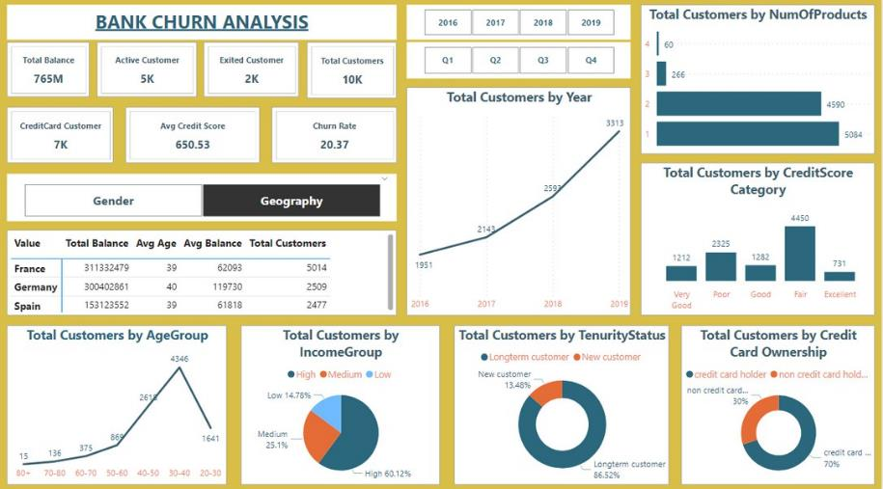
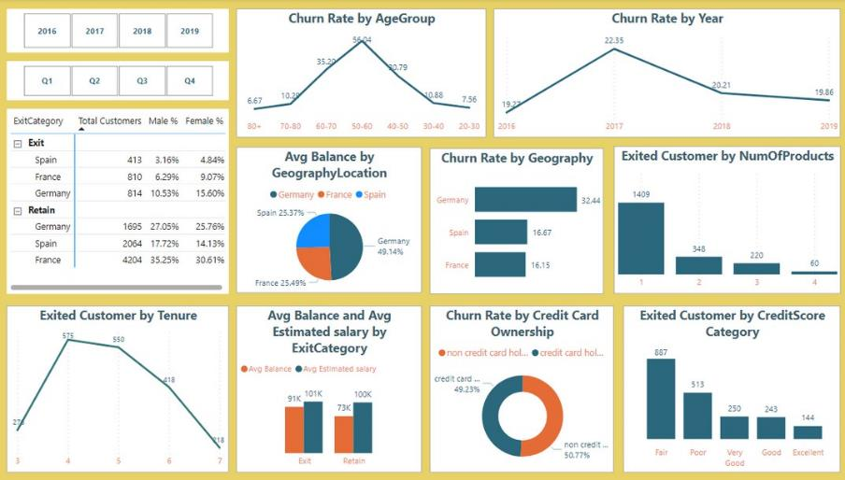
Dashboard

Slide 18
T H A N K Y O U

